Slide 1
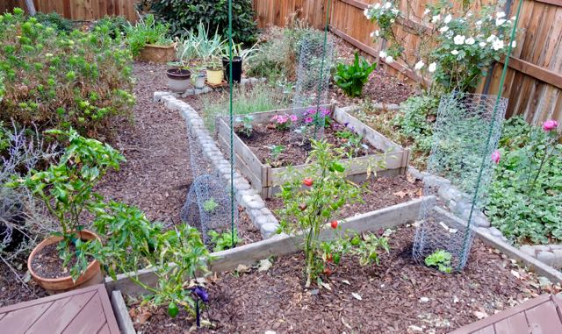
Meyer lemon
Lantana
Alum root
Irises
African daisy
Rosemary
Euryops
White roses
Four chard in pots
Fennel
Calla lily
Arugula
Petunias
Russian sage
Stir fry broccoli
Lavender roses
Mild red pepper
Cajun red pepper
Periwinkle
Leaf lettuce
Mild red pepper
Leaf lettuce

